Slide 1
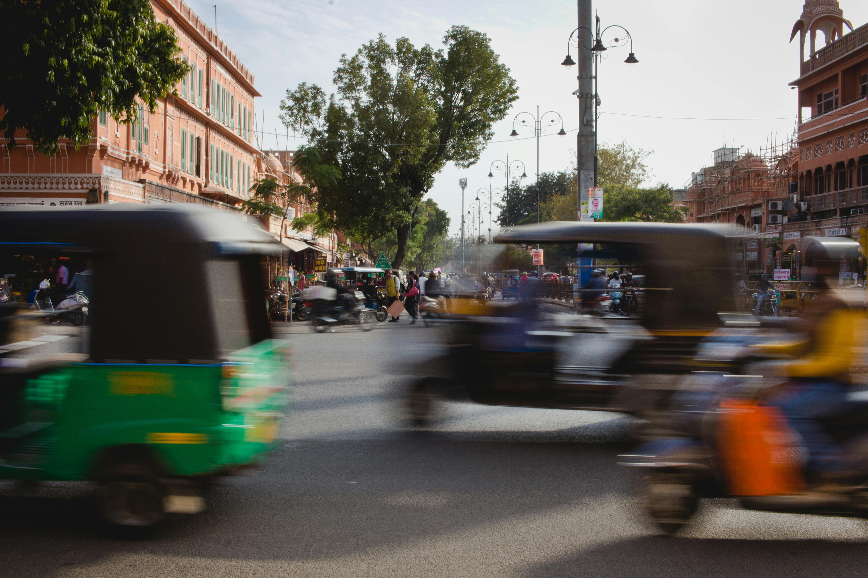
KOLKATA ROAD ACCIDENT SEVERITY
SUBTITLE : A MACHINE LEARNING APPROACH TO IMPROVE ROAD SAFETY.
PRESENTED BY: SACHIN, ROUNAQUE,
YASH,
GOPAL,
MAHARSHI
1

Slide 2
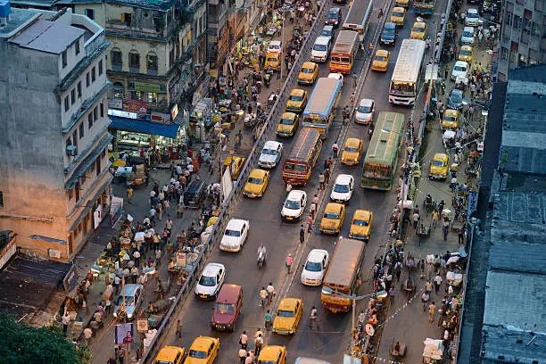
INTRODUCTION
1
Objective
2
About Dataset
3
Cleaning & preparation
4
EDA
5
Model Training & Comparison
6
Future Scope
1

Slide 3
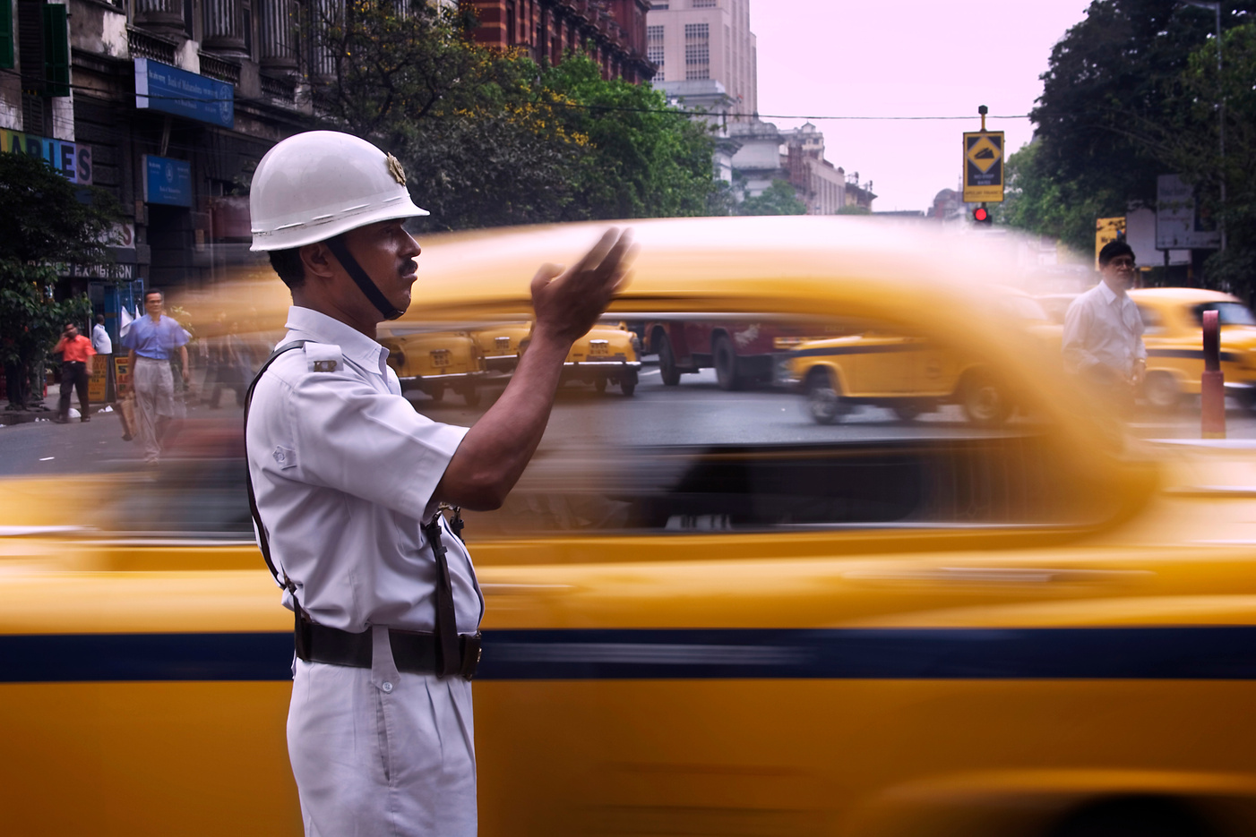
THE OBJECTIVE
Our project is about predicting the severity of a road accident before it happens, using machine learning. We will look at how we can use data from real accidents that happened in “Kolkata” in between 2021 -2022 to understand the key factors that lead to more dangerous outcomes.
2

Slide 4
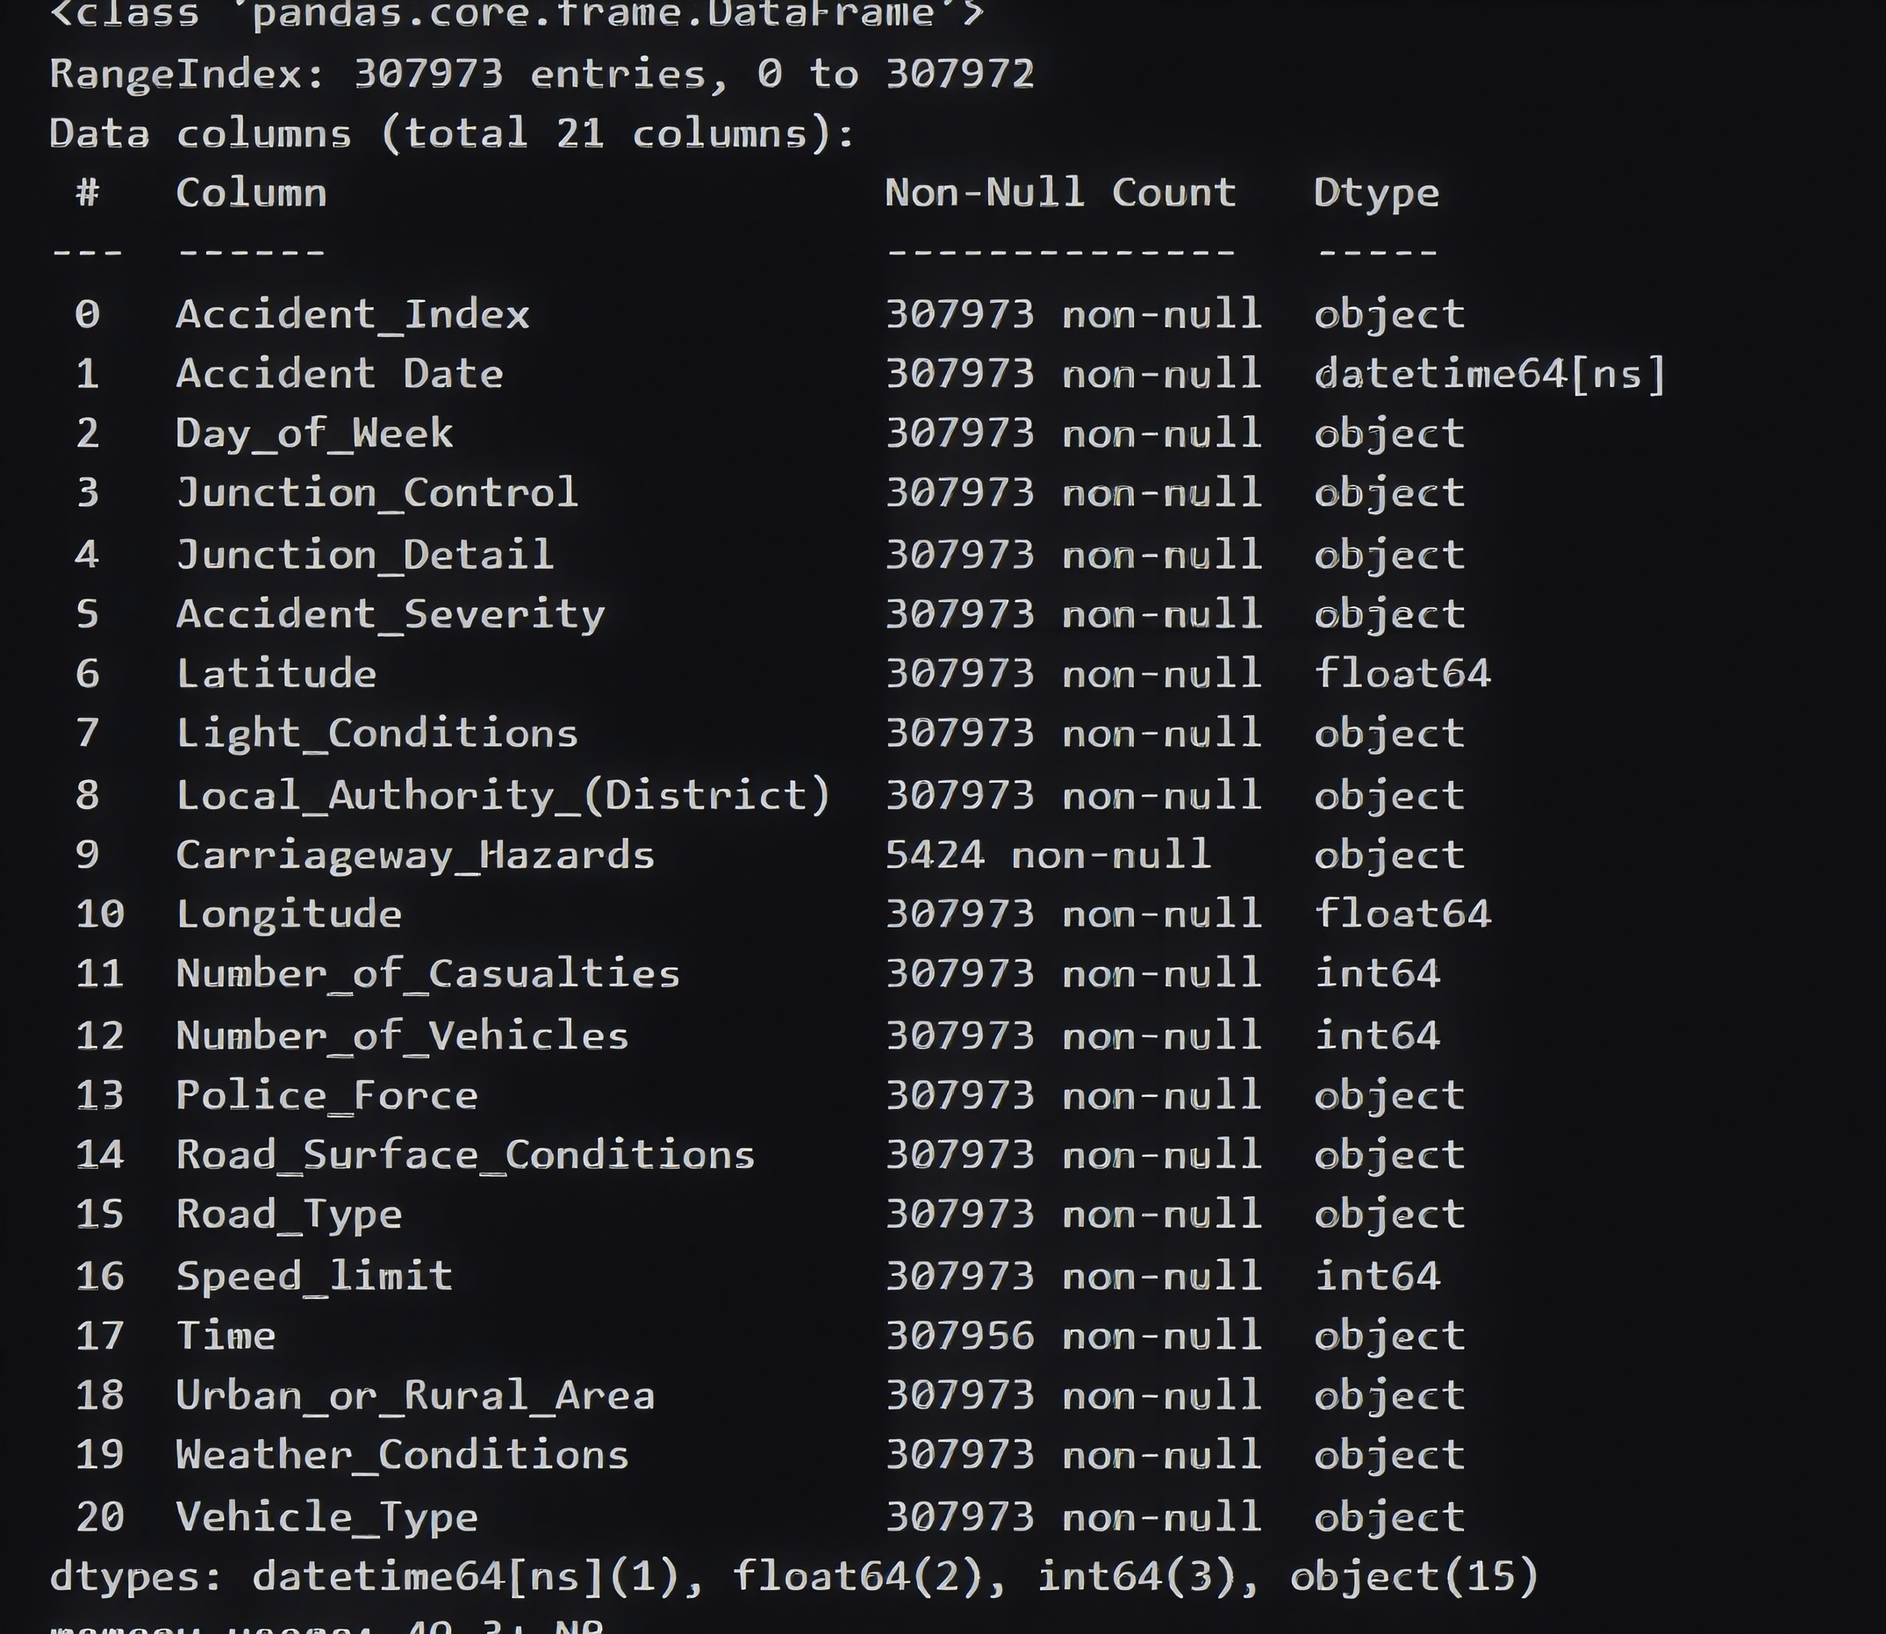
ABOUT DATASET
SIZE:
OVER 300,000 UNIQUE ACCIDENT RECORDS.
KEY FEATURES:
ENVIRONMENT: WEATHER CONDITIONS, LIGHT CONDITIONS
LOCATIONS: LONGITUDE,LATITUDE, ROAD TYPE , SPEED LIMIT
TIME : HOUR OF THE DAY,HOUR OF THE WEEK
3

Slide 5
CLEANING & PREPARATION
Checked for Nulls: First, I analyzed the dataset and confirmed there were no missing (null) values to worry about.
Converted Data Types: The Accident Date column was converted to a datetime object. This allowed us to extract meaningful features like Hours and Day_of_Week.
Encoded the Target: The model cannot understand text. The target variable Accident_Severity ('Slight', 'Serious', 'Fatal') was encoded into numeric values (1, 2, 3).
Handling "Leaky" Features: I removed Number_of_Casualties from the input features. This is "target leakage" as it's an outcome of the accident, not a cause.
Final Result: A clean, fully numeric dataset ready for analysis and modeling.
4

Slide 6

EDA
Before modeling, we analyzed the data. I found clear patterns, like peaks during rush hour. But the single most important discovery was Class Imbalance. As you can see, 85.6% of the data is for 'Slight' accidents. 'Fatal' accidents are extremely rare, making up only 1.2%. This imbalance is the central challenge of this project."
5

Slide 7
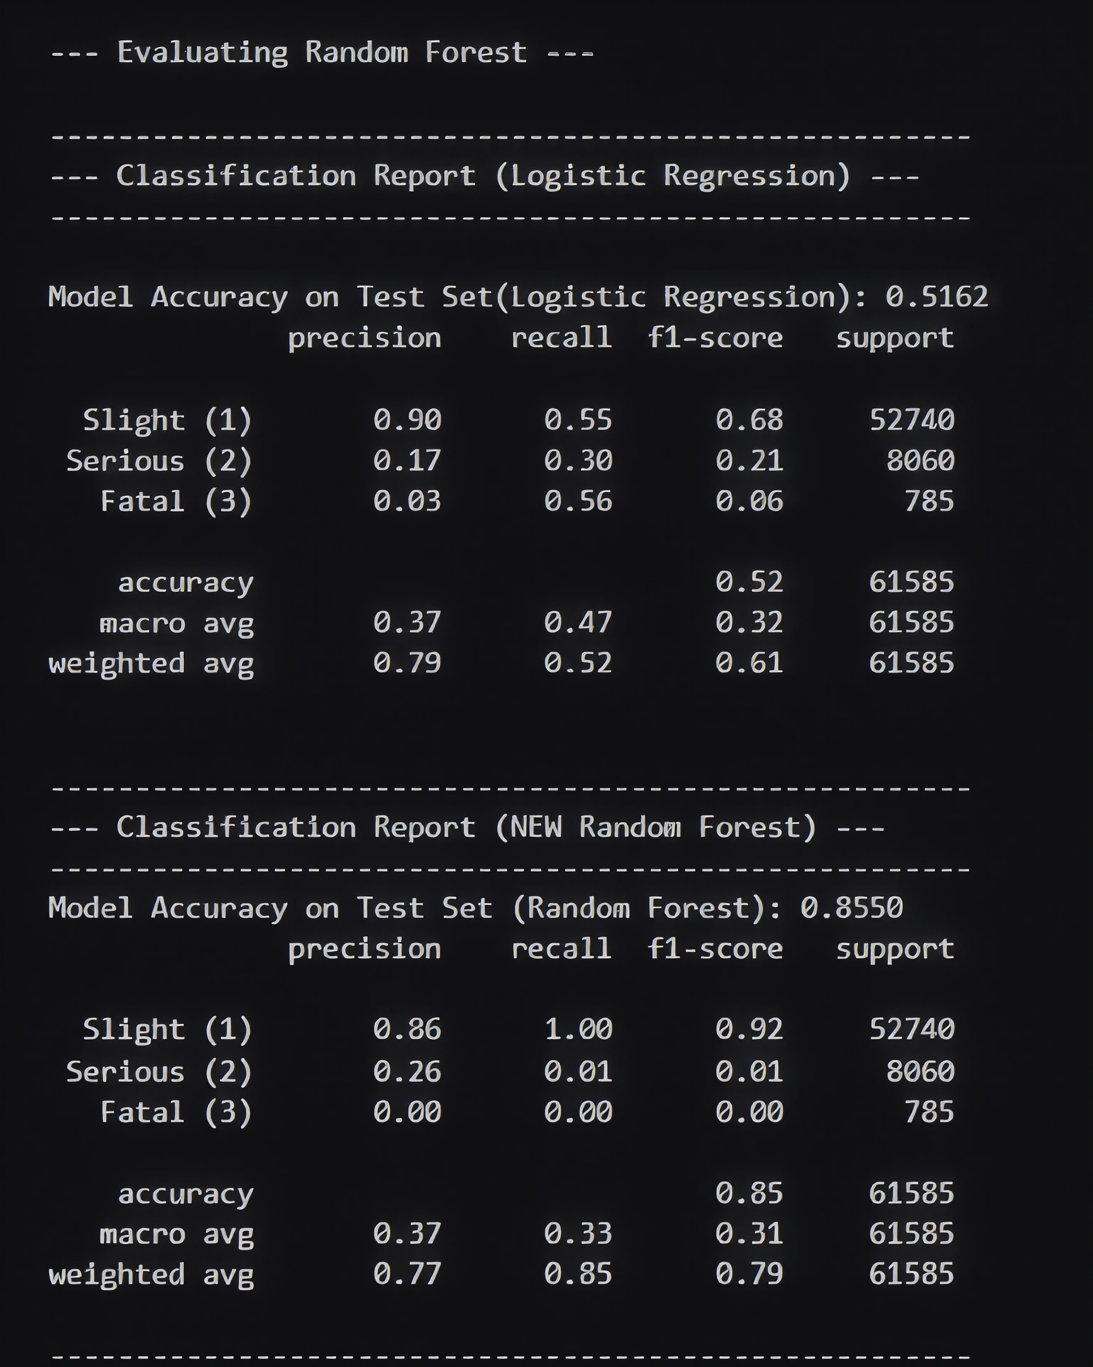
MODEL TTAINING & COMPARISON
THE PROBLEM:
OUR MODEL WAS "LAZY" AND ONLY PREDICTED "SLIGHT" TO GET A FAKE 85% ACCURACY.
THE FIX:
WE MUST FORCE THE MODEL TO PAY ATTENTION TO THE RARE CLASSES ("SERIOUS" & "FATAL").
THE TECHNIQUE:
WE RE-TRAINED THE LOGISTICREGRESSION MODEL USING THE CLASS_WEIGHT="BALANCED" PARAMETER.
WHAT THIS DOES:
IT CHANGES THE RULES. IT APPLIES A MUCH HIGHER PENALTY TO THE MODEL FOR MISSING A "FATAL" OR "SERIOUS" ACCIDENT.
7

Slide 8
FUTURE SCOPE
PREDICTIVE ACCIDENT ALERT SYSTEM
PUBLIC AWARENESS & POLICY PLANNING
ADD MORE CITIES DATA & INCREASE DATASET FOR TRAINING OUR MODEL
8

Slide 9
THANK YOU
9

